Slide 1


Slide 2
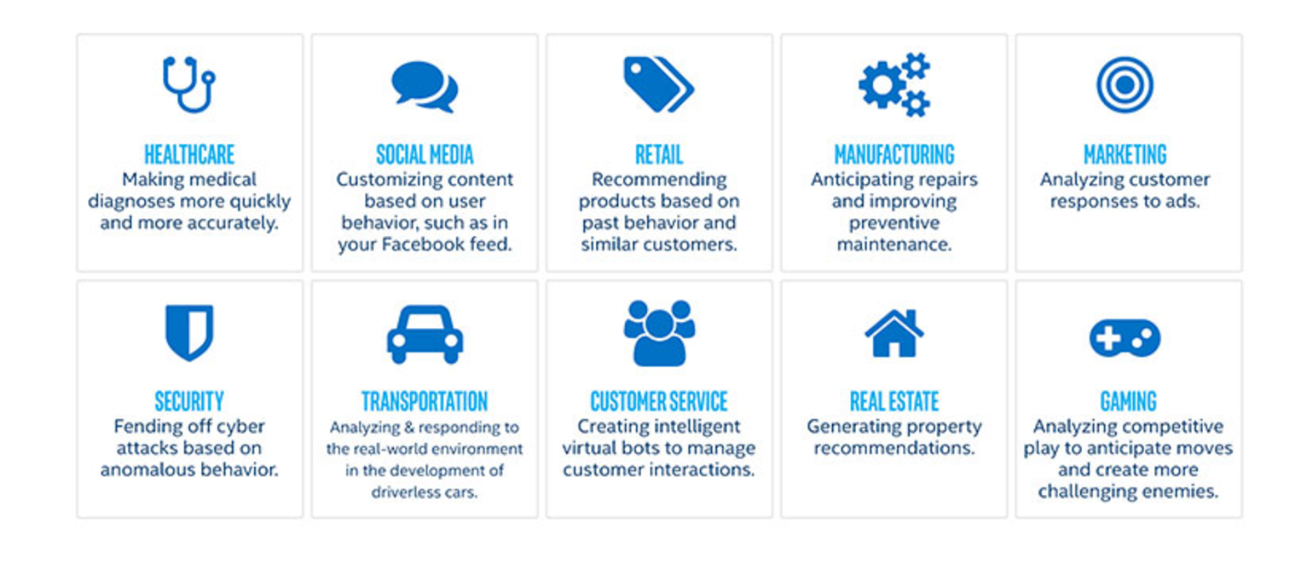

Applications of Machine learning
Notes:
In London

Slide 3
Naming few are:
Speech recognition
Voice/Face/Finger print recognition
Natural Language Processing - Sentiment analysis/Language identification and translation
Medical diagnosis
Recommendations engines and Market basket analysis
Spam detection
Bioinformatics/computational biology
Content (image, video, text) categorization
Notes:
In London

Slide 4
How to design for a machine learning problem ?
Data
Feature Selection
Model Selection
Learning
Evaluation
Notes:
In London

Slide 5
How to design for a machine learning problem ?
Data
Feature Selection
Model Selection
Learning
Evaluation
Notes:
In London

Slide 6
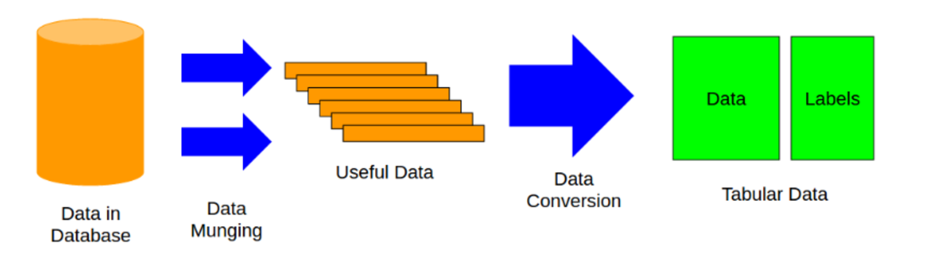
Data
Notes:
In London

Slide 7
How to design for a machine learning problem ?
Data
Feature Selection
Model Selection
Learning
Evaluation
Notes:
In London

Slide 8
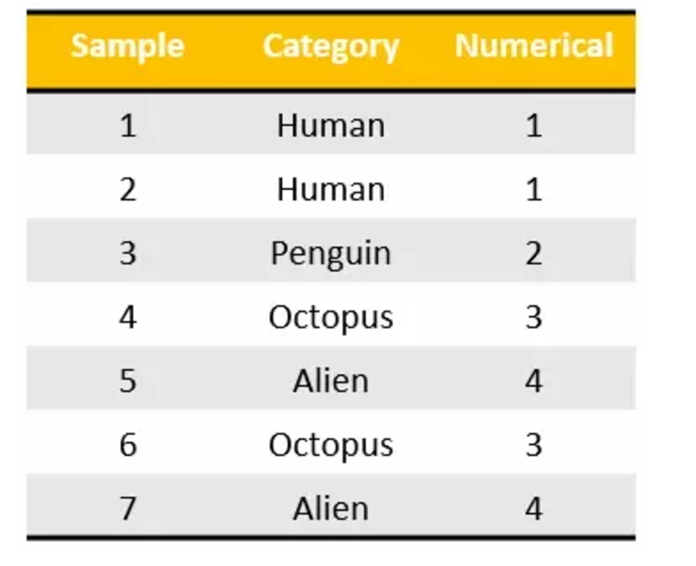
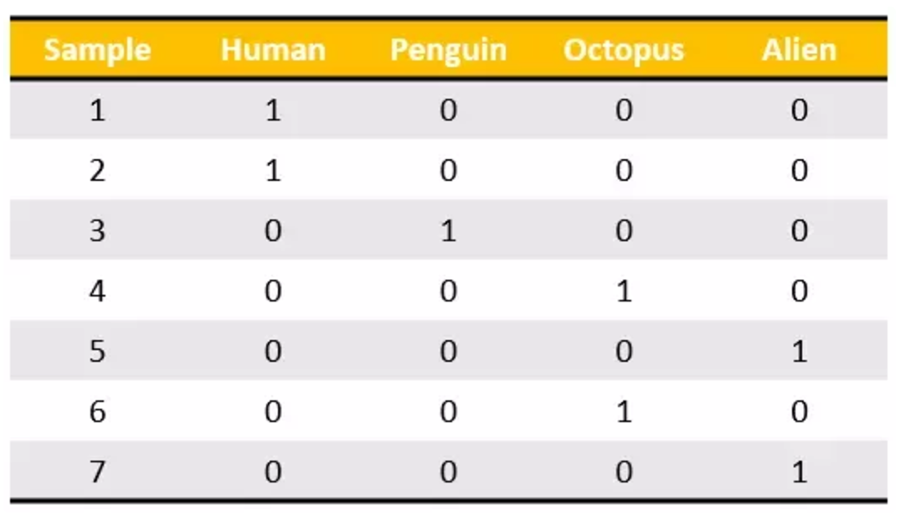
Feature scaling ,label encoding and one hot encoding
Notes:
Mathematically, one hot encoding produces a balanced matrix, which is easy to understand during complex computations inside algorithms.

Slide 9
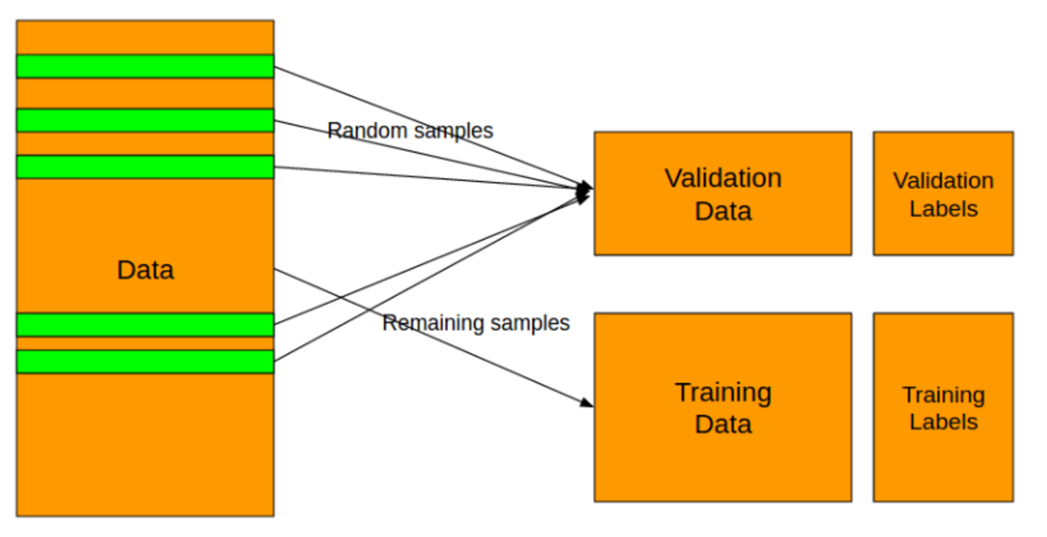
Split the data set
Notes:
In London

Slide 10
How to design for a machine learning problem ?
Data
Feature Selection
Model Selection
Learning
Evaluation
Notes:
In London

Slide 11
Identify the problem
Multi-variable regression
Multi classification problem
Classification problem
Binary classification problem
Notes:
In London

Slide 12
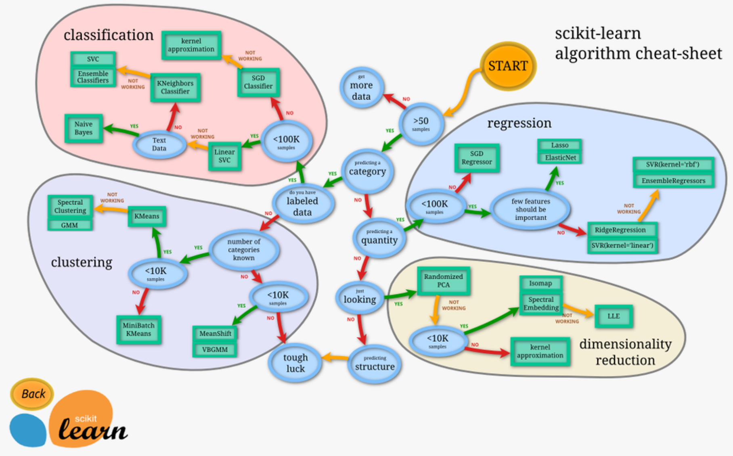
Notes:
In London

Slide 13
How to design for a machine learning problem ?
Data
Feature Selection
Model Selection
Learning
Evaluation
Notes:
In London

Slide 14

Actual learning
Notes:
In London

Slide 15
How to design for a machine learning problem ?
Data
Feature Selection
Model Selection
Learning
Evaluation
Notes:
In London

Slide 16
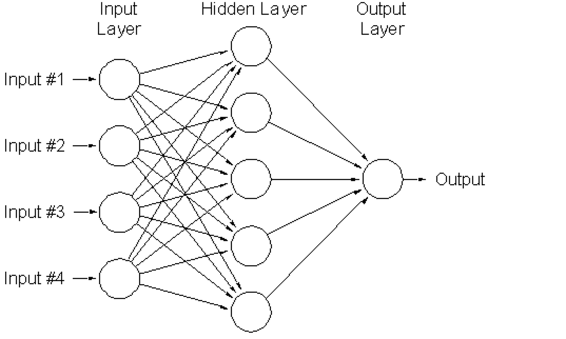
Revisiting artificial neural networks

Slide 17
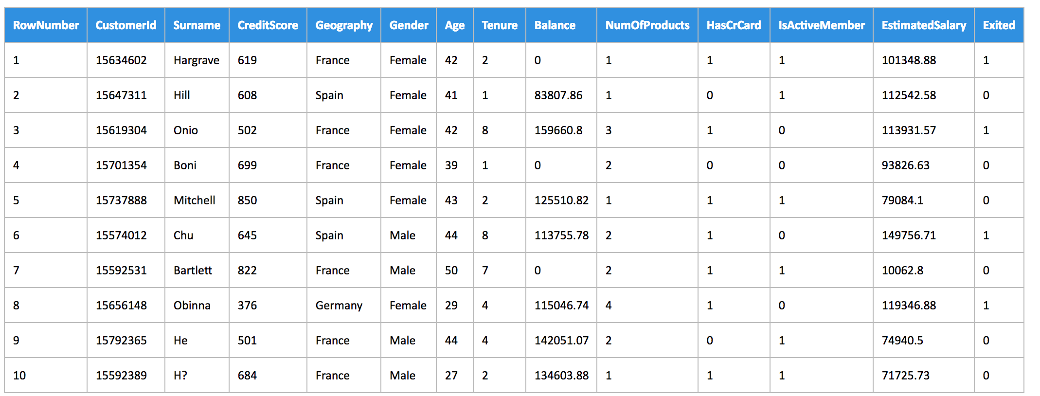
Given data from customers predict customer is about to stay or leave.

Slide 18
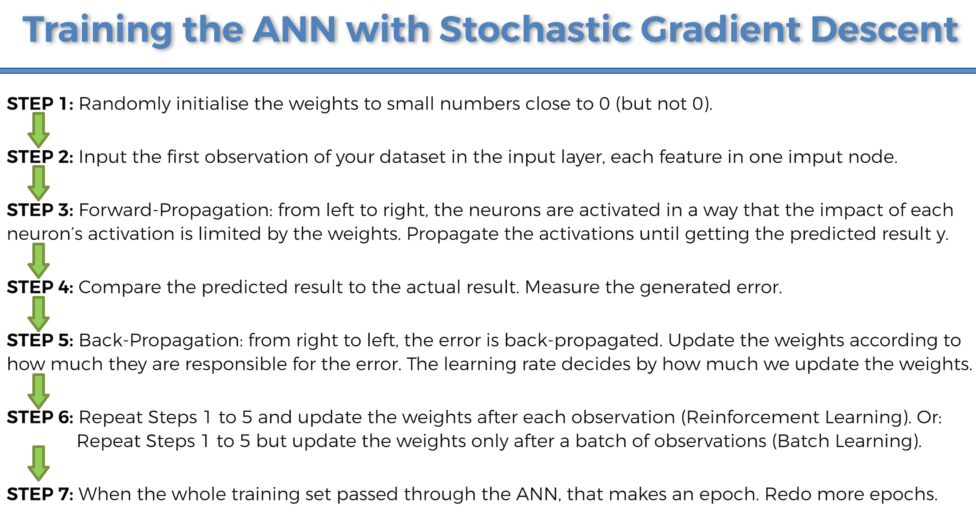
Revisiting artificial neural networks
Notes:
While in GD, you have to run through ALL the samples in your training set to do a single update for a parameter in a particular iteration, in SGD, on the other hand, you use ONLY ONE or SUBSET of training sample from your training set to do the update for a parameter in a particular iteration. If you use SUBSET, it is called Minibatch Stochastic gradient Descent

Slide 19
Exercise
Notes:
While in GD, you have to run through ALL the samples in your training set to do a single update for a parameter in a particular iteration, in SGD, on the other hand, you use ONLY ONE or SUBSET of training sample from your training set to do the update for a parameter in a particular iteration. If you use SUBSET, it is called Minibatch Stochastic gradient Descent

Slide 20
Applications in Expedia
Sentiment classifier for reviews
Domain entity recognition in nautilus
Auto-moderation/categorization of text reviews/photos
Auto-categorization of lodging content
Dynamic weights to scorers of various search results in ESS
Many more ….

Slide 21
Sentiment classifier - Information Extraction Pipeline
Concept Extraction
Concept Resolution
Sentiment Analysis

Slide 22
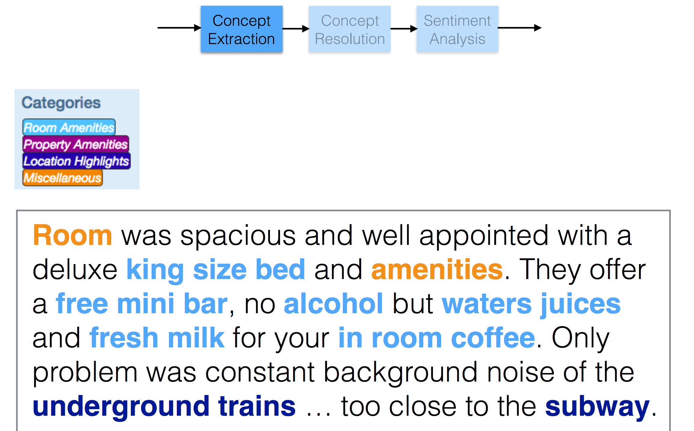
Sentiment classifier - Information Extraction Pipeline

Slide 23
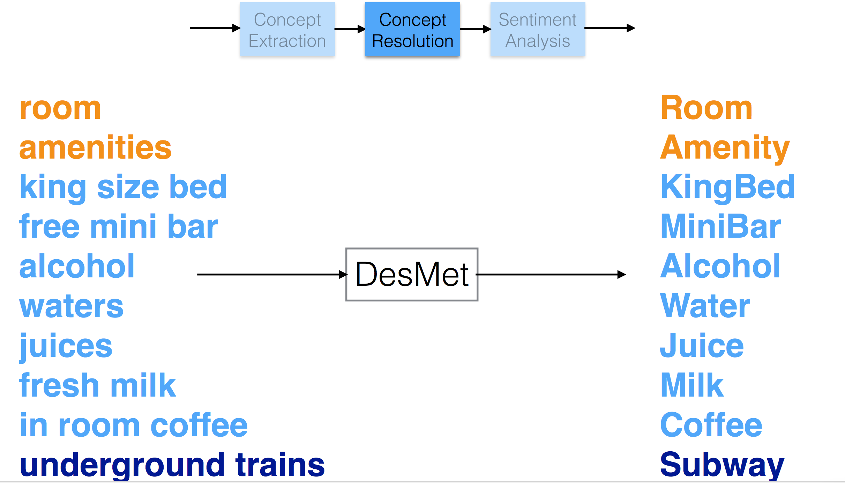
Sentiment classifier - Information Extraction Pipeline

Slide 24
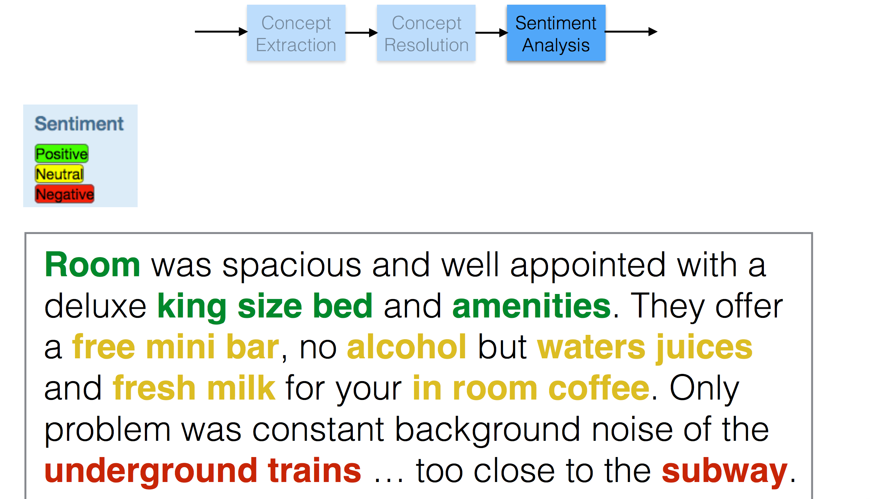
Sentiment classifier - Information Extraction Pipeline

Slide 25
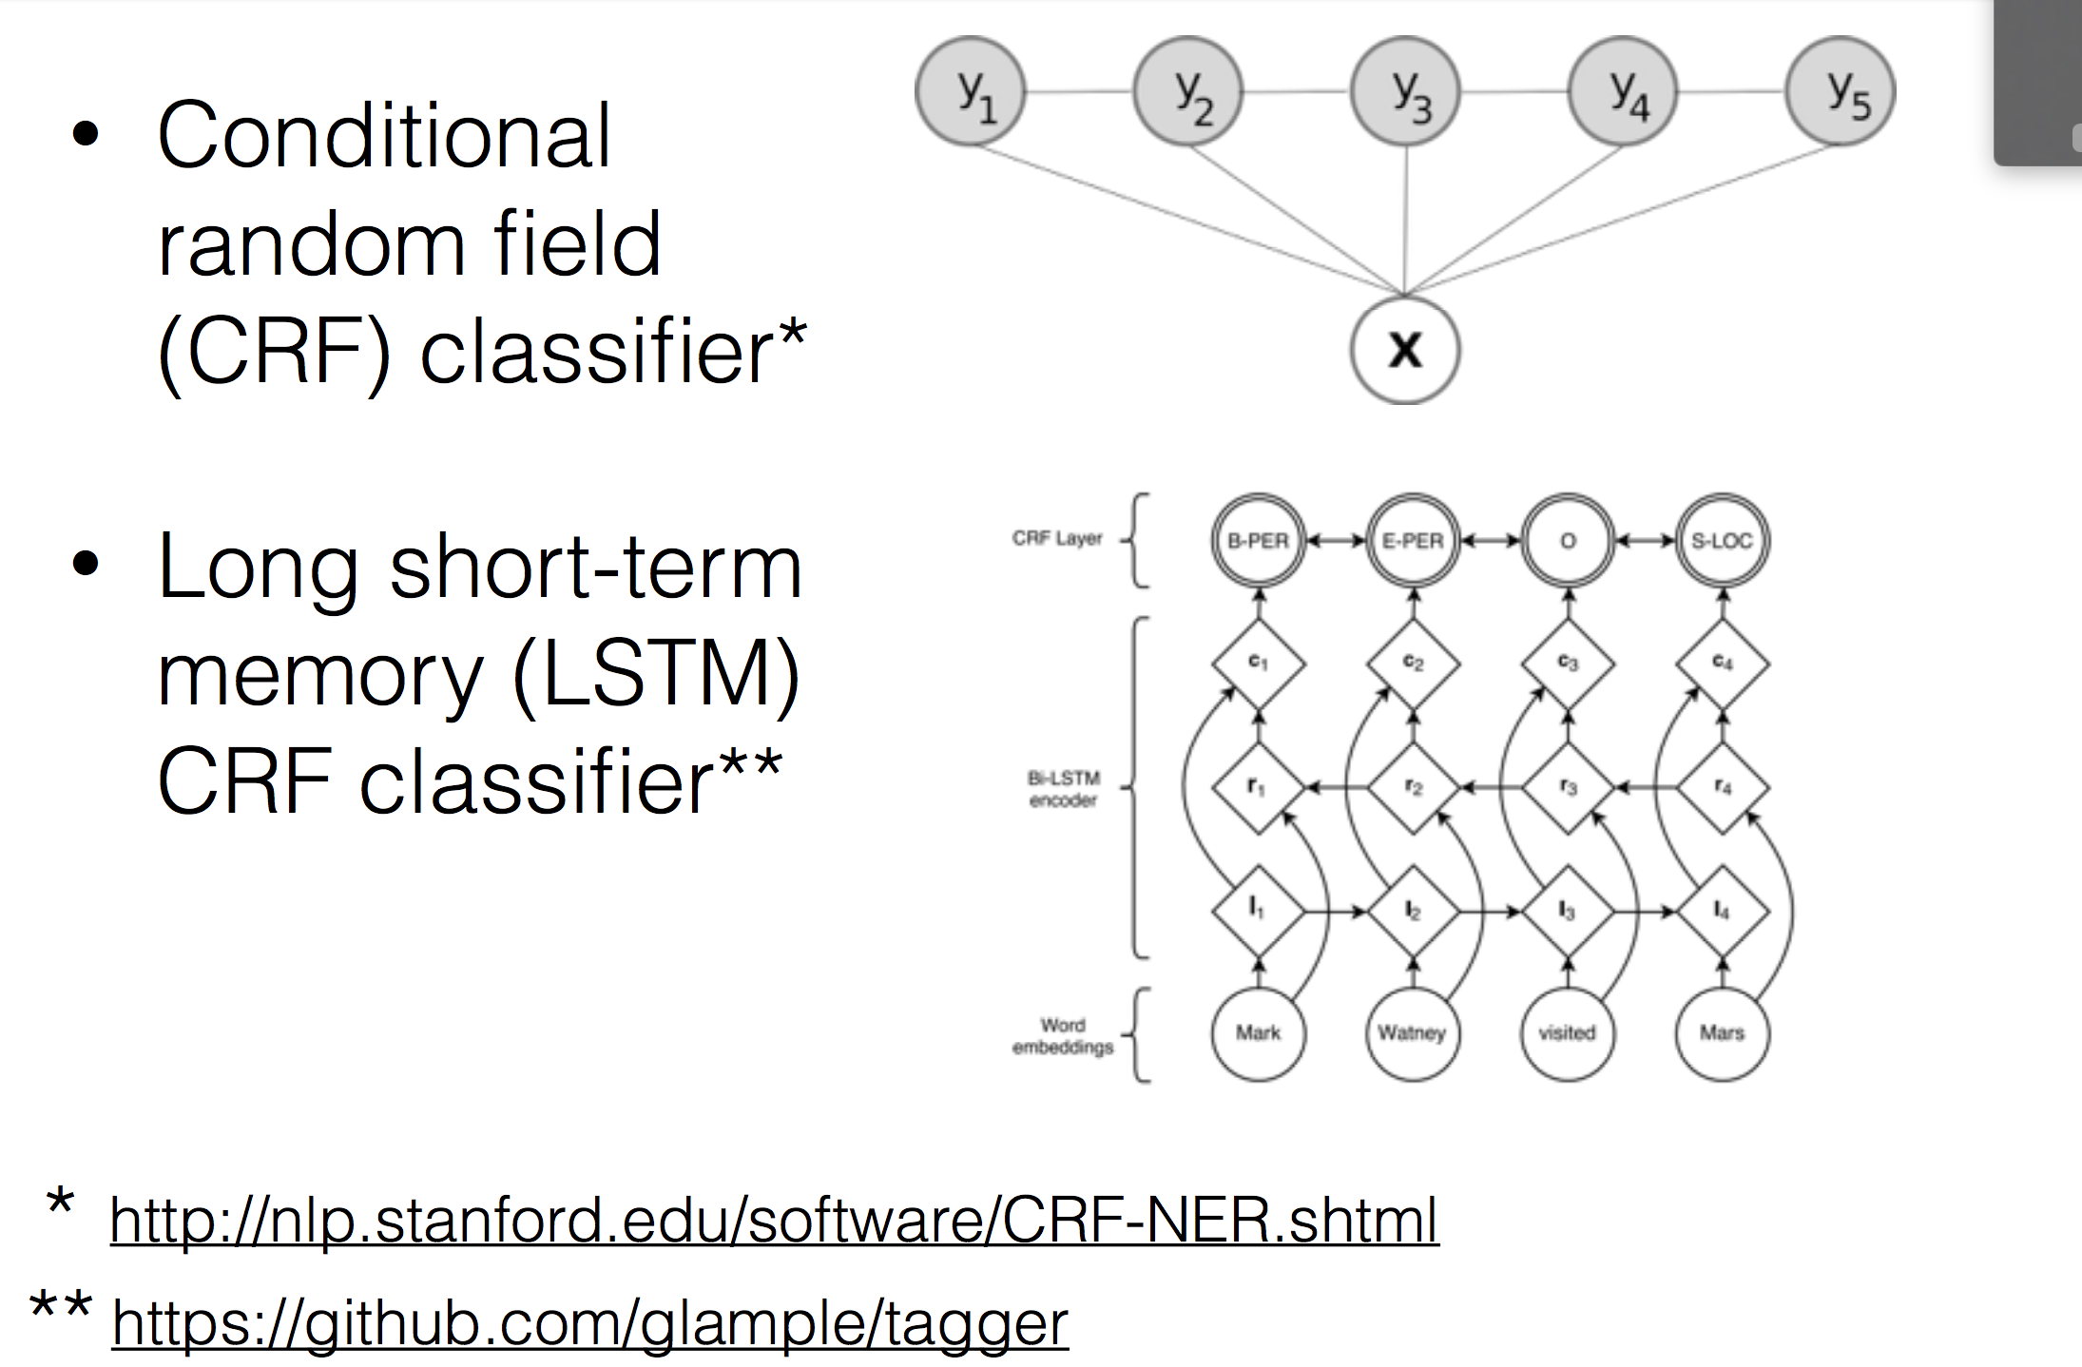
Concept Extraction

Slide 26
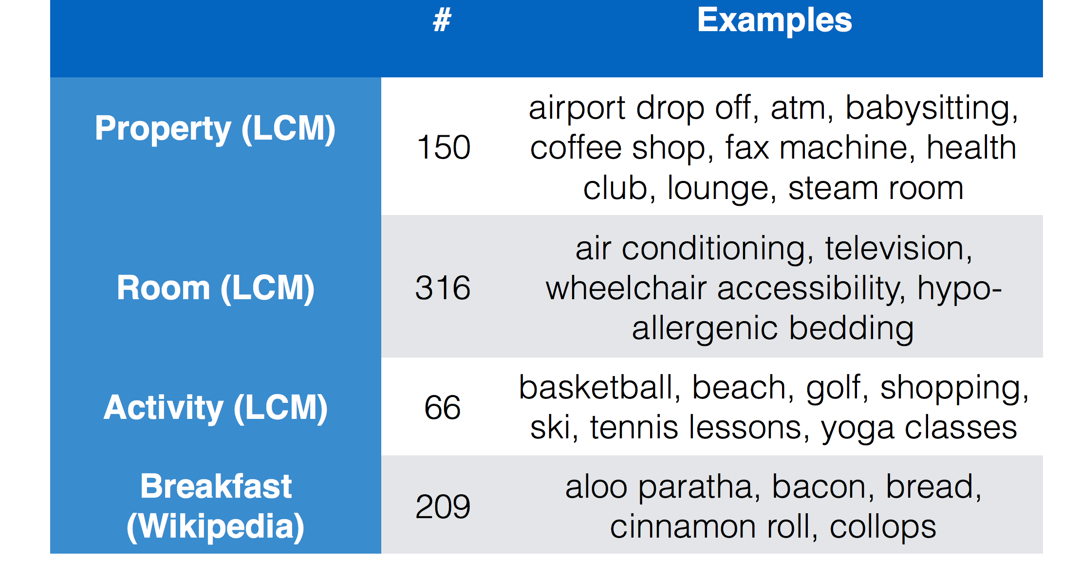
Concept Extraction

Slide 27
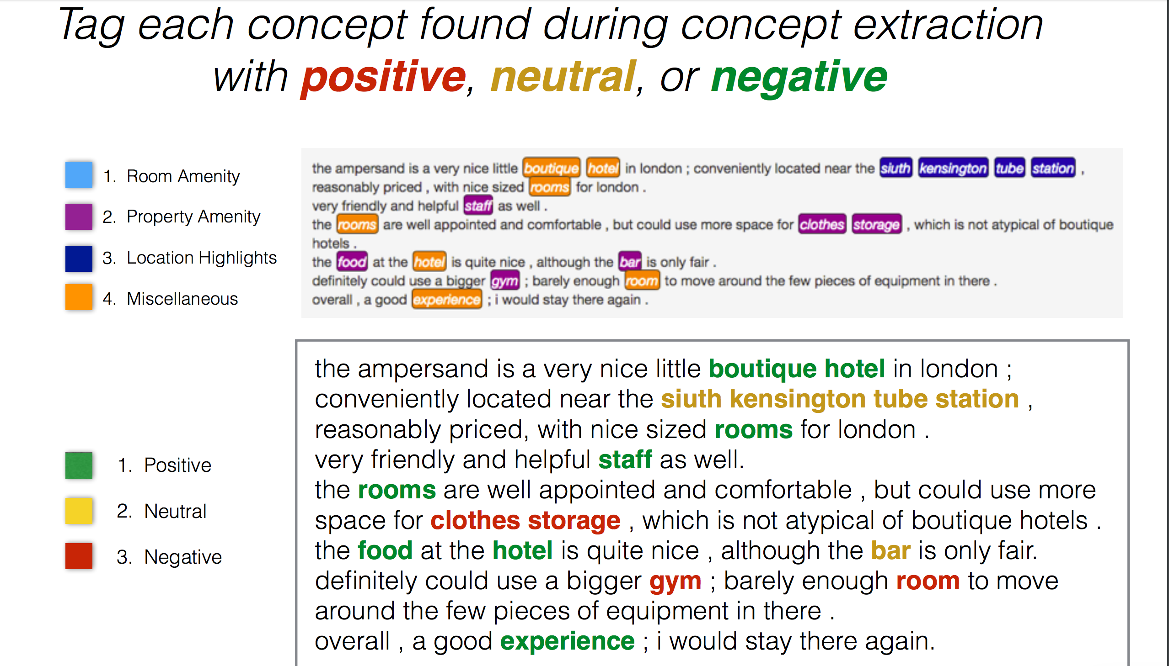
Sentiment Analysis

Slide 28
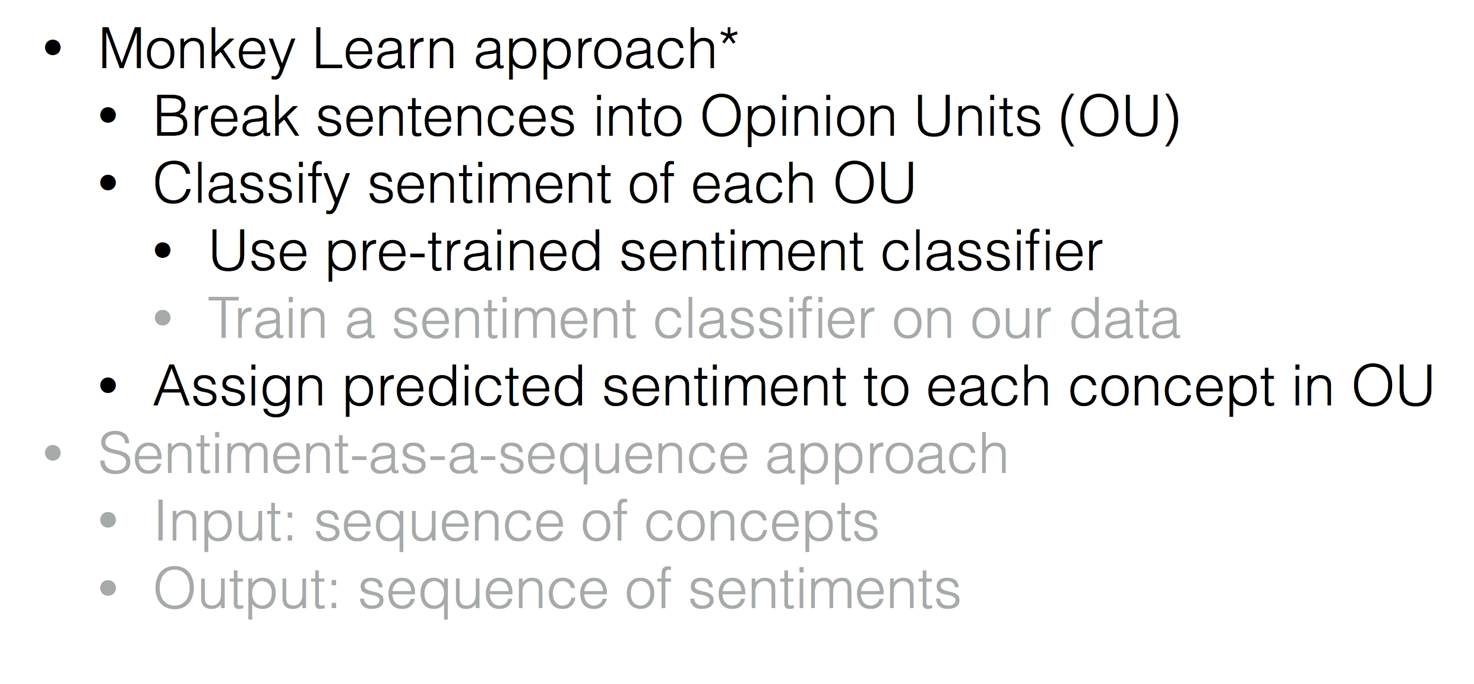
Sentiment Analysis
https://blog.monkeylearn.com/aspect-analysis-from-reviews-using-machine-learning/

Slide 29
Demo
It is a work by Brooke Cowan and Guy Masse from Expedia

